Slide 1
Distributed Shared-Memory

Slide 2
Distributed Shared-Memory and Directory-Based Coherence
Snooping protocol requires communication with all caches on every cache miss, including writes of potentially shared data
We can increase the memory bandwidth and interconnection bandwidth by distributing the memory
  separates local memory traffic from remote memory traffic,
  reduces the bandwidth demands on the memory system and on the interconnection network

Slide 3
Directory protocol
A directory keeps the state of every block that may be cached.
Information in the directory includes which caches (or collections of caches) have copies of the block, whether it is dirty and so on

Slide 4
Directory protocol
Single directory used in a multicore is not scalable.
The directory must be distributed, but the distribution must be done in a way that the coherence protocol knows where to find the directory information for any cached block of memory.
The obvious solution is to distribute the directory along with the memory, so that different coherence requests can go to different directories, just as different memory requests go to different memories.
A distributed directory retains the characteristic that the sharing status of a block is always in a single known location

Slide 5
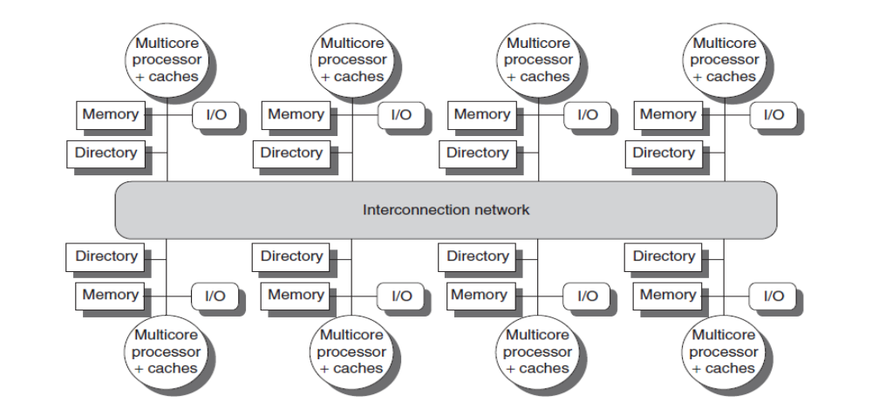

Slide 6
A directory is added to each node to implement cache coherence in a distributed-memory multiprocessor.
A node is shown as a single multicore chip, and the directory information for the associated memory may reside either on or off the multicore.
Each directory is responsible for tracking the caches that share the memory addresses of the portion of memory in the node.
The coherence mechanism would handle both the maintenance of the directory information and any coherence actions needed within the multicore node

Slide 7
Directory-Based Cache Coherence Protocols: The Basics
There are two primary operations that a directory protocol must implement:
  handling a read miss and handling a write to a shared,
  clean cache block

Slide 8
In a simple directory protocol, the following states could be possible
Shared—One or more nodes have the block cached, and the value in memory is up to date (as well as in all the caches).
Uncached—No node has a copy of the cache block.
Modified—Exactly one node has a copy of the cache block, and it has written the block, so the memory copy is out of date. The processor is called the owner of the block.
We must track which nodes have copies of that block, since those copies will need to be invalidated on a write

Slide 9
Solution
Keep a bit vector for each memory block.
When the block is shared, each bit of the vector indicates whether the corresponding processor chip (which is likely a multicore) has a copy of that block.
We can also use the bit vector to keep track of the owner of the block when the block is in the exclusive state

Slide 10
Types of messages
The local node is the node where a request originates.
The home node is the node where the memory location and the directory entry of an address reside.
The physical address space is statically distributed, so the node that contains the memory and directory for a given physical address is known.
The directory must be accessed when the home node is the local node, since copies may exist in yet a third node, called a remote node.

Slide 11
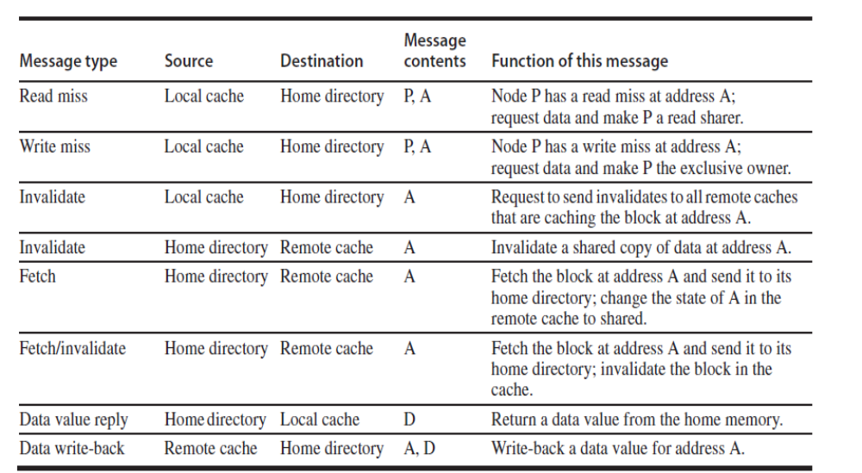
P = requesting node number, A = requested address, and D = data contents

Slide 12
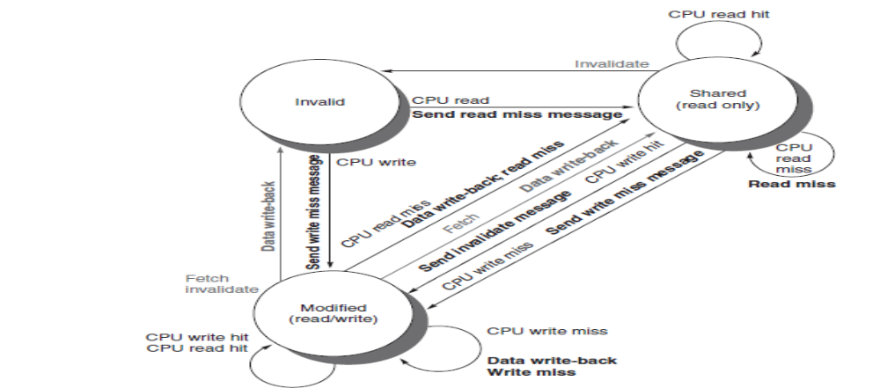
An Example Directory Protocol - State transition diagram for an individual cache block in a directory based system.

Slide 13
message sent to a directory causes two different types of actions:
  updating the directory state and sending additional messages to satisfy the request.
  The states in the directory represent the three standard states for a block; unlike in a snooping scheme
directory state indicates the state of all the cached copies of a memory block, rather than for a single cache block

Slide 14
In addition to the state of each block, the directory must track the set of nodes that have a copy of a block; we use a set called Sharers to perform this function.

Slide 15
When a block is in the uncached state, the copy in memory is the current value, so the only possible requests for that block are
  Read miss—The requesting node sent the requested data from memory, and the requestor is made the only sharing node. The state of the block is made shared.
  Write miss—The requesting node sent the value and becomes the sharing node. The block is made exclusive to indicate that the only valid copy is cached. Sharers indicates the identity of the owner

Slide 16
When the block is in the shared state, the memory value is up to date, so the same two requests can occur:
  Read miss—The requesting node sent the requested data from memory, and the requesting node is added to the sharing set.
  Write miss—The requesting node sent the value. All nodes in the set Sharers are sent invalidate messages, and the Sharers set is to contain the identity of the requesting node. The state of the block is made exclusive.

Slide 17
Performance
Coherence influences cache miss rate
  Coherence misses
    True sharing misses
      Write to shared block (transmission of invalidation)
      Read an invalidated block
    False sharing misses
      Read an unmodified word in an invalidated block

Slide 18
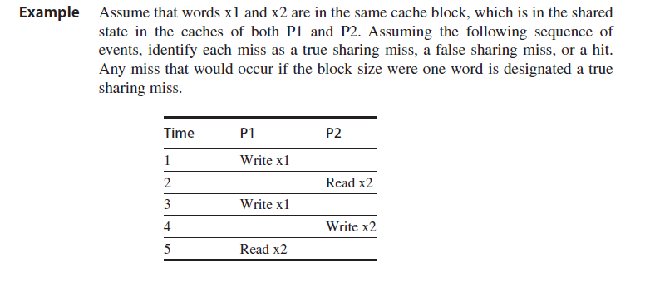
Performance

Slide 19
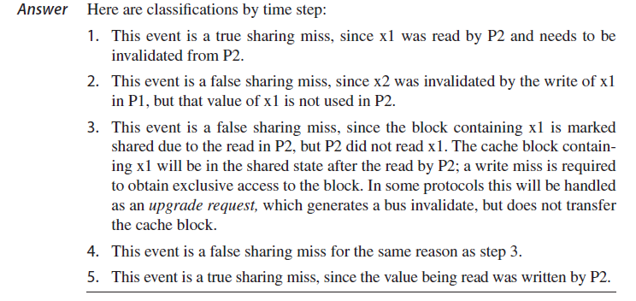
Performance

